Slide 1
Debt Letters MVP

Slide 2
The History
During the session of the 115th Congress, the Veterans Fair Debt Notice Act of 2018 was passed, establishing a wide-sweeping set of provisions, the most important of which are aimed at better informing Veterans when and why they have incurred a debt with the VA, what their options are to resolve it, and a digital method by which to receive those communications.
Fast forward two years, and nothing has happened. In the last month DEPO was engaged by our partners in the Veterans Experience Office (VEO) with a proposal (XXX) to prioritize a slimmed down set of requirements for development into an MVP.
VEO submitted to us a solution-oriented document that outlines their desired set of requirements and outcomes. DEPO officially accepted this project via the standard intake process and organized Benefits and Memorials Team 2 (BAM2) as the implementation team focuses on delivering an initial MVP that realizes actual value both for the Veteran (clarity, awareness, empathy, accuracy, timeliness) AND for the business (digital, progress).

Slide 3

The Ask
Simple: Apply the DEPO implementation methodology to identify and QUICKLY launch on VA.gov an agreed-upon MVP that improves the debt management experience for Veterans and demonstrates substantive progress on a high-priority Congressional initiative.

Slide 4

The Challenges
A lot of open questions
Information is comm’d across a lot of channels
Paper process will continue to exist
Technical landscape is unclear
Extremely high-visibility

Slide 5
What we Know: The Experience

Slide 6
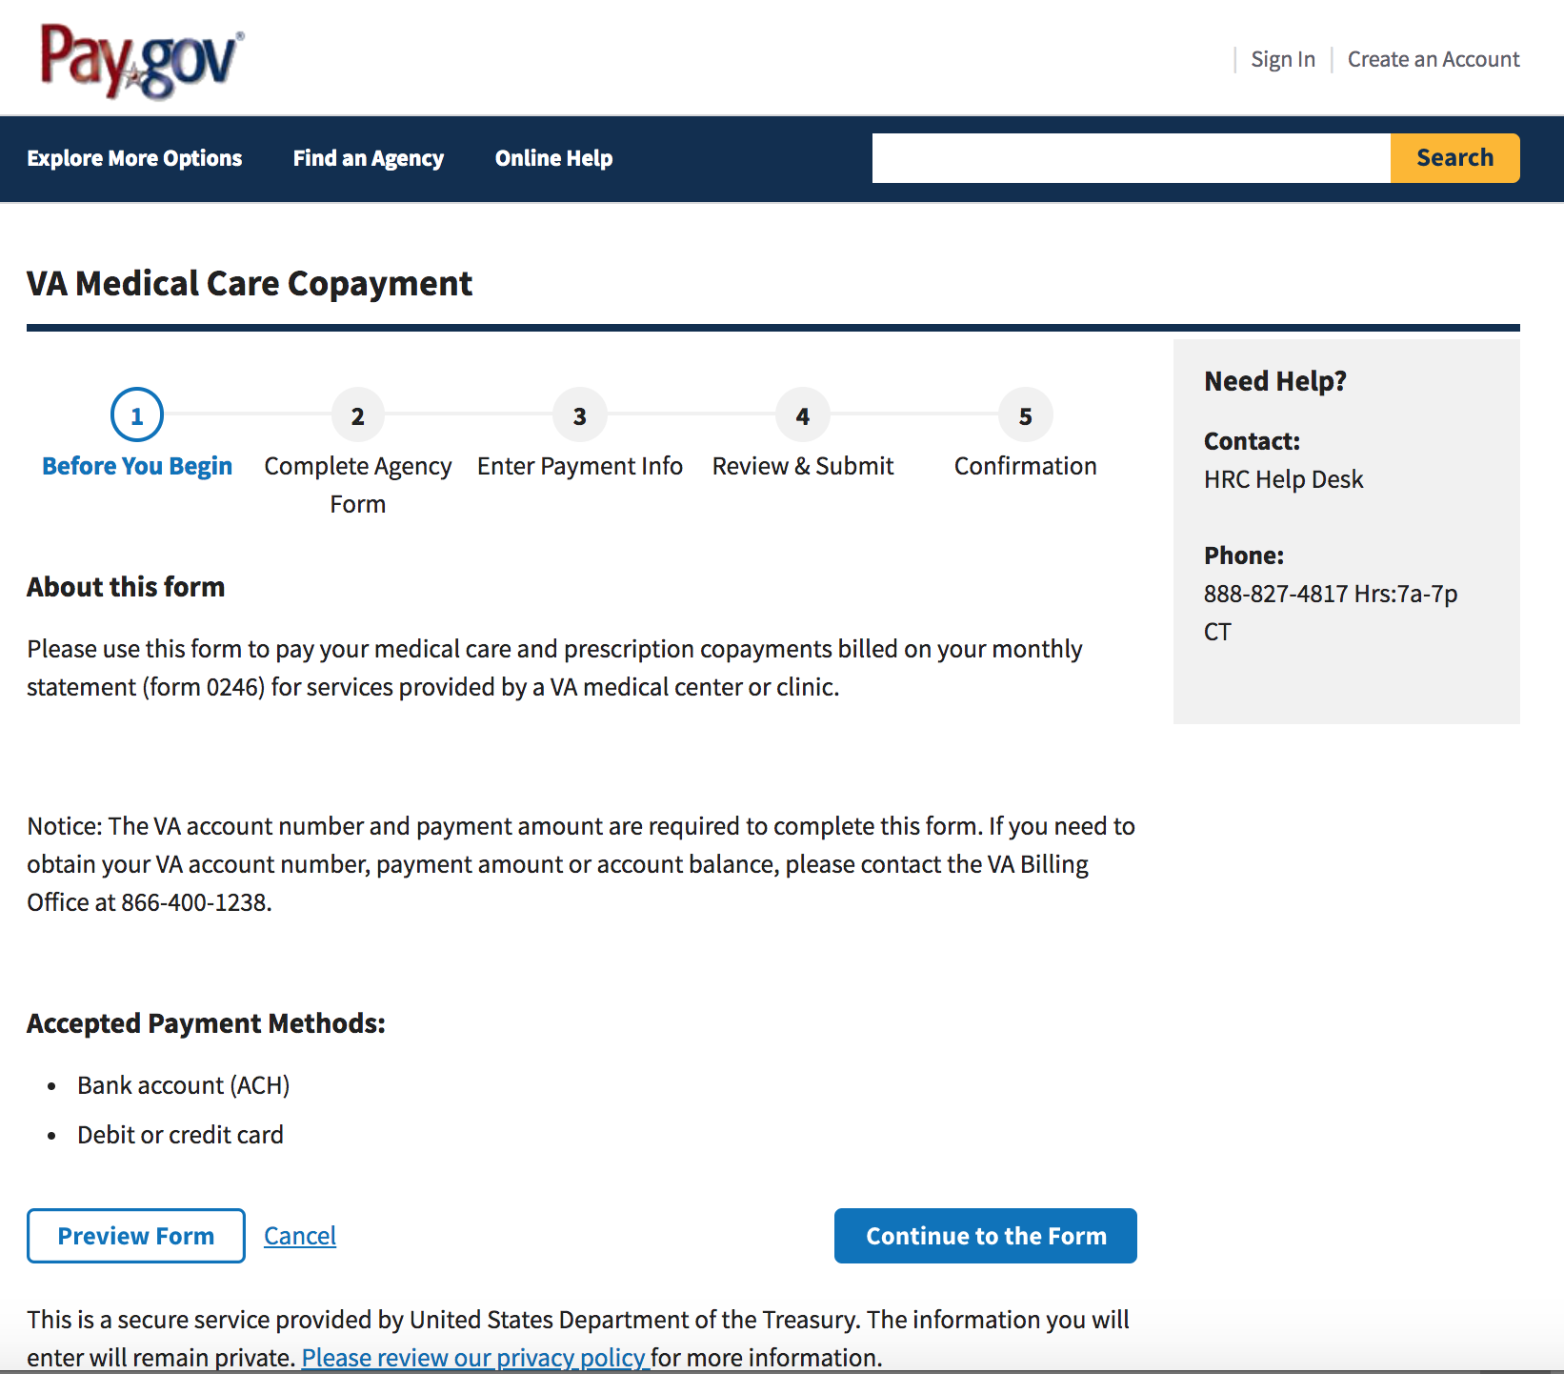
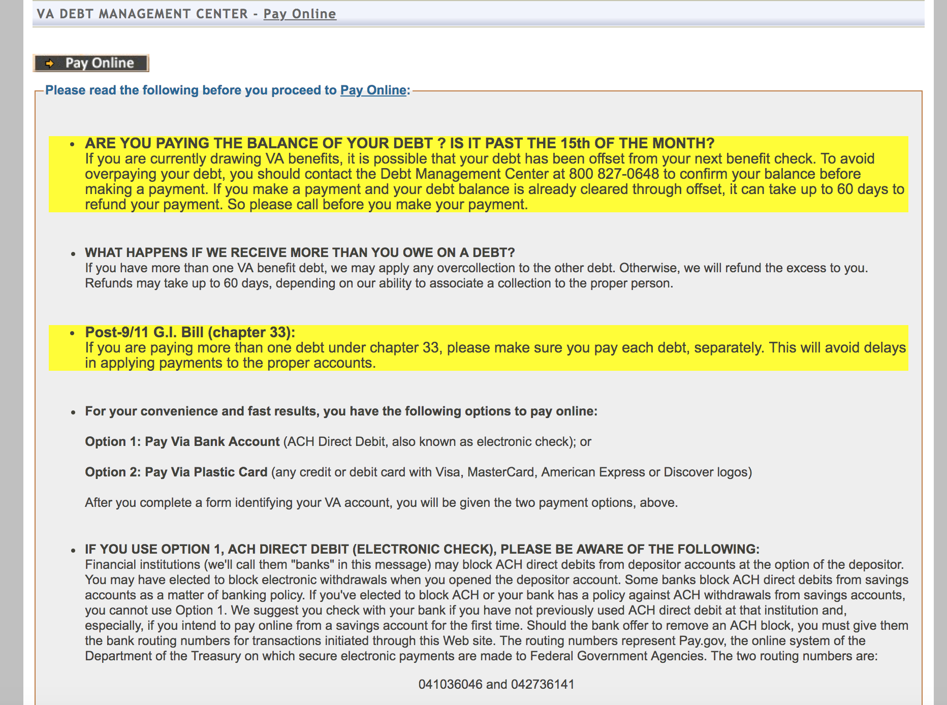
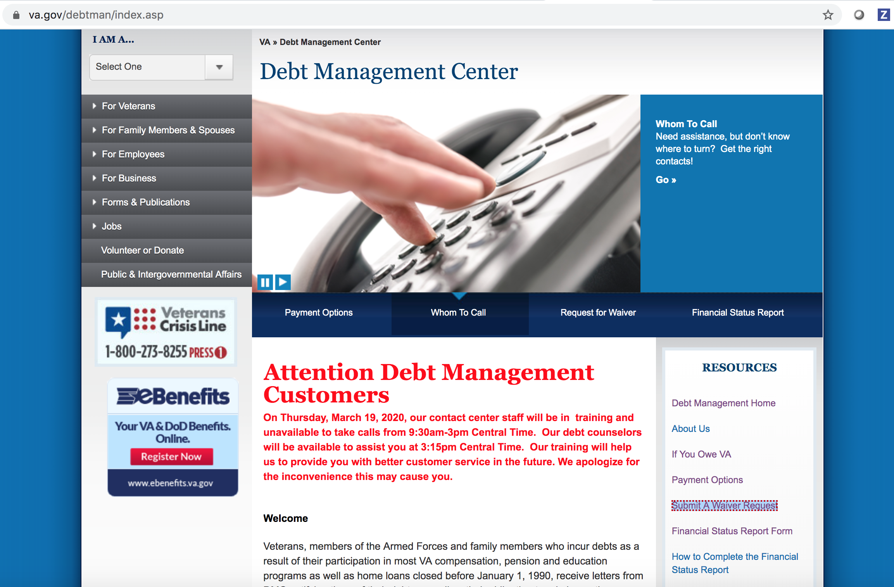
The Digital Experience Today (~XX%)
The digital debt management/resolution process is confusing, disjointed, and aggressive.

Slide 7
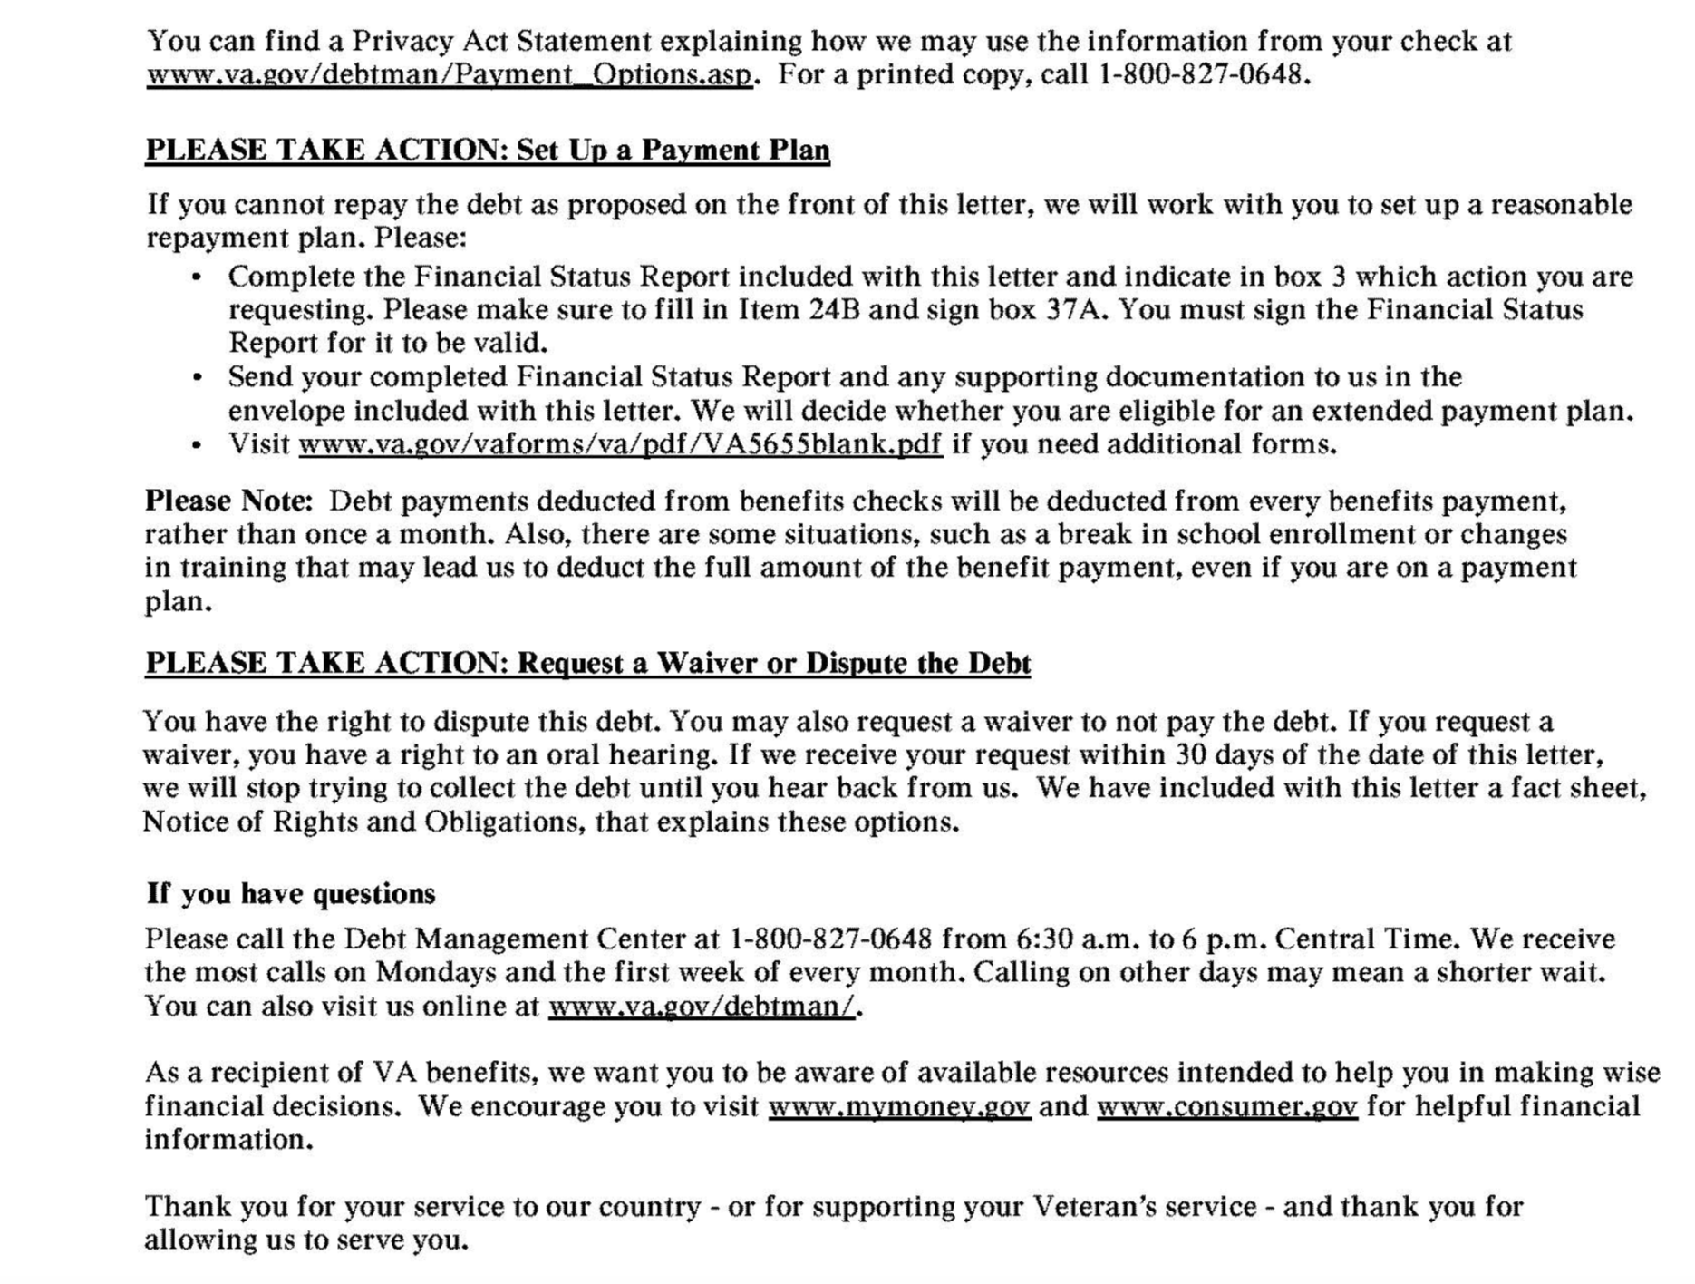
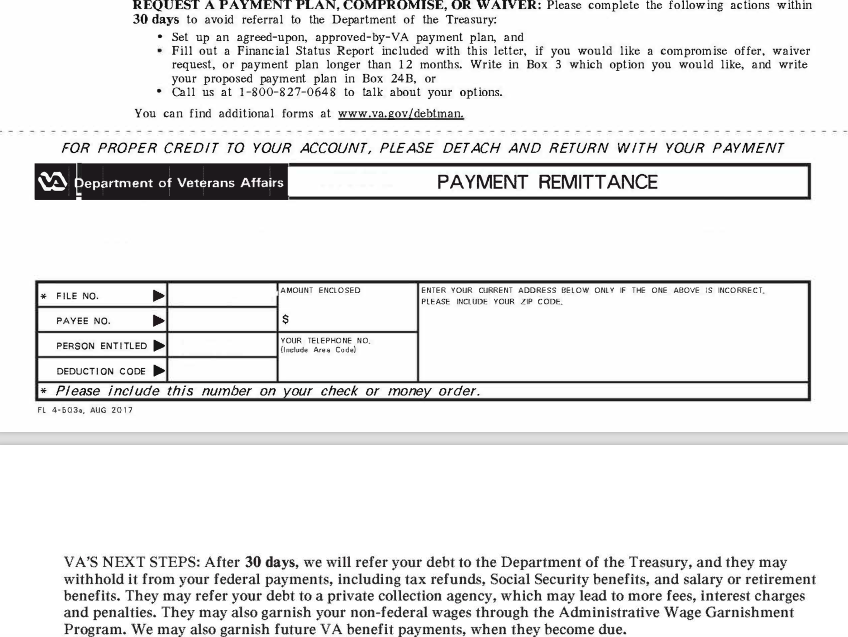
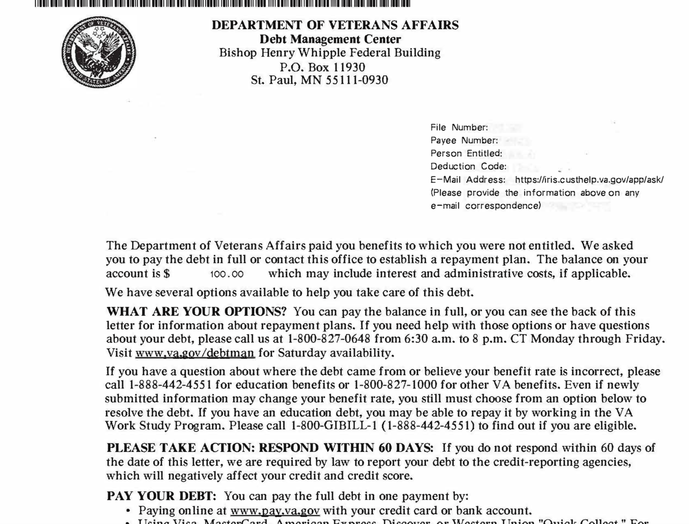
But Wait! Most of it is on PAPER! (~XX%)
Surprise! You owe us money!
We’re docking next month’s disability check :)
Currently, while Veterans can call the VA to manage/adjudicate debt, the only standardized process for communicating information about debt outbound to Veterans, is via printed letters sent through the mail.
Notes:
EE
There were a lot of issues identified, but we had to scope our efforts towards something we (the team) could do within the last 1.5 weeks that would have the most impact.
We collected research observations in Mural, and collected possible opportunities we identified. Then we charted the opportunities on feasibility and impact for CRCL -accesses.
Then we voted on solutions we could provide that we thought were the most impactful
[Note: Explain how we could’ve solved any problem in the Mural, but went through targeted exercises to scope it down and voted.]

Slide 8
Technical Landscape
Notes:
EE

Slide 9
Letters, Letters, Letters…
Any Veteran-related document that is digitized, ultimately winds up within a document respository (eFolder) which exists for each Veteran and itself resides within the VA’s claims management system, VBMS
Debt letters can be generated by various business lines around the VA (EDU, Compensation, etc), and come in various types (think “New Debt Alert” or “3rd Notice of Deliquency”); the exact number of different types is not clear, but we have heard “probably like 50” O_O…But don’t get scared just yet, because…
Currently, only a small subset of the total # of letter types have been digitized and are being actively sent to Veteran eFolders; this means we can focus on the 5-10 “eFolder-supported” debt letters
That being said, it is extremely unclear at this point how well documented the letter type/name taxonomy is, and even more unclear how consistently it is applied to the actual documents in the eFolders…
But it’s not all bad news! We’ve been told there is an existing integration between vets-api and the Veteran eFolder (https://github.com/department-of-veterans-affairs/lighthouse-bgs); it seems to contain services which may be useful, and at the very least lay the groundwork for new functionality without the need to work through establishing a brand new connection

Slide 10
So What Should we do First?
Identify ALL of the relevant stakeholders, SMEs, and most importantly, nail down a single sign-off official (Product Owner); then...
Conduct light-weight interviews with them to better understand the problem space so we can…
Complete our Product Outline and use it to reach agreement w/the PO on the MVP we will deliver! https://github.com/department-of-veterans-affairs/va.gov-team/blob/master/products/debt-letters-mvp/readme.md
Take a first past @ our KPIs! https://github.com/department-of-veterans-affairs/va.gov-team/blob/master/products/debt-letters-mvp/discovery-research/kpi-setting-pre-workshop-template.md
Dig into the existing integrations between VA.gov and the VBMS-efolder: https://github.com/department-of-veterans-affairs/lighthouse-bgs

Slide 11





Feed the momentum
Now
Present our work to VEO and DMC
Address questions technical hurdles
Reach agreement on scope/timing of MVP
Demonstrate progress to VEO/DMC each sprint
Launch & Iterate!

